Slide 1
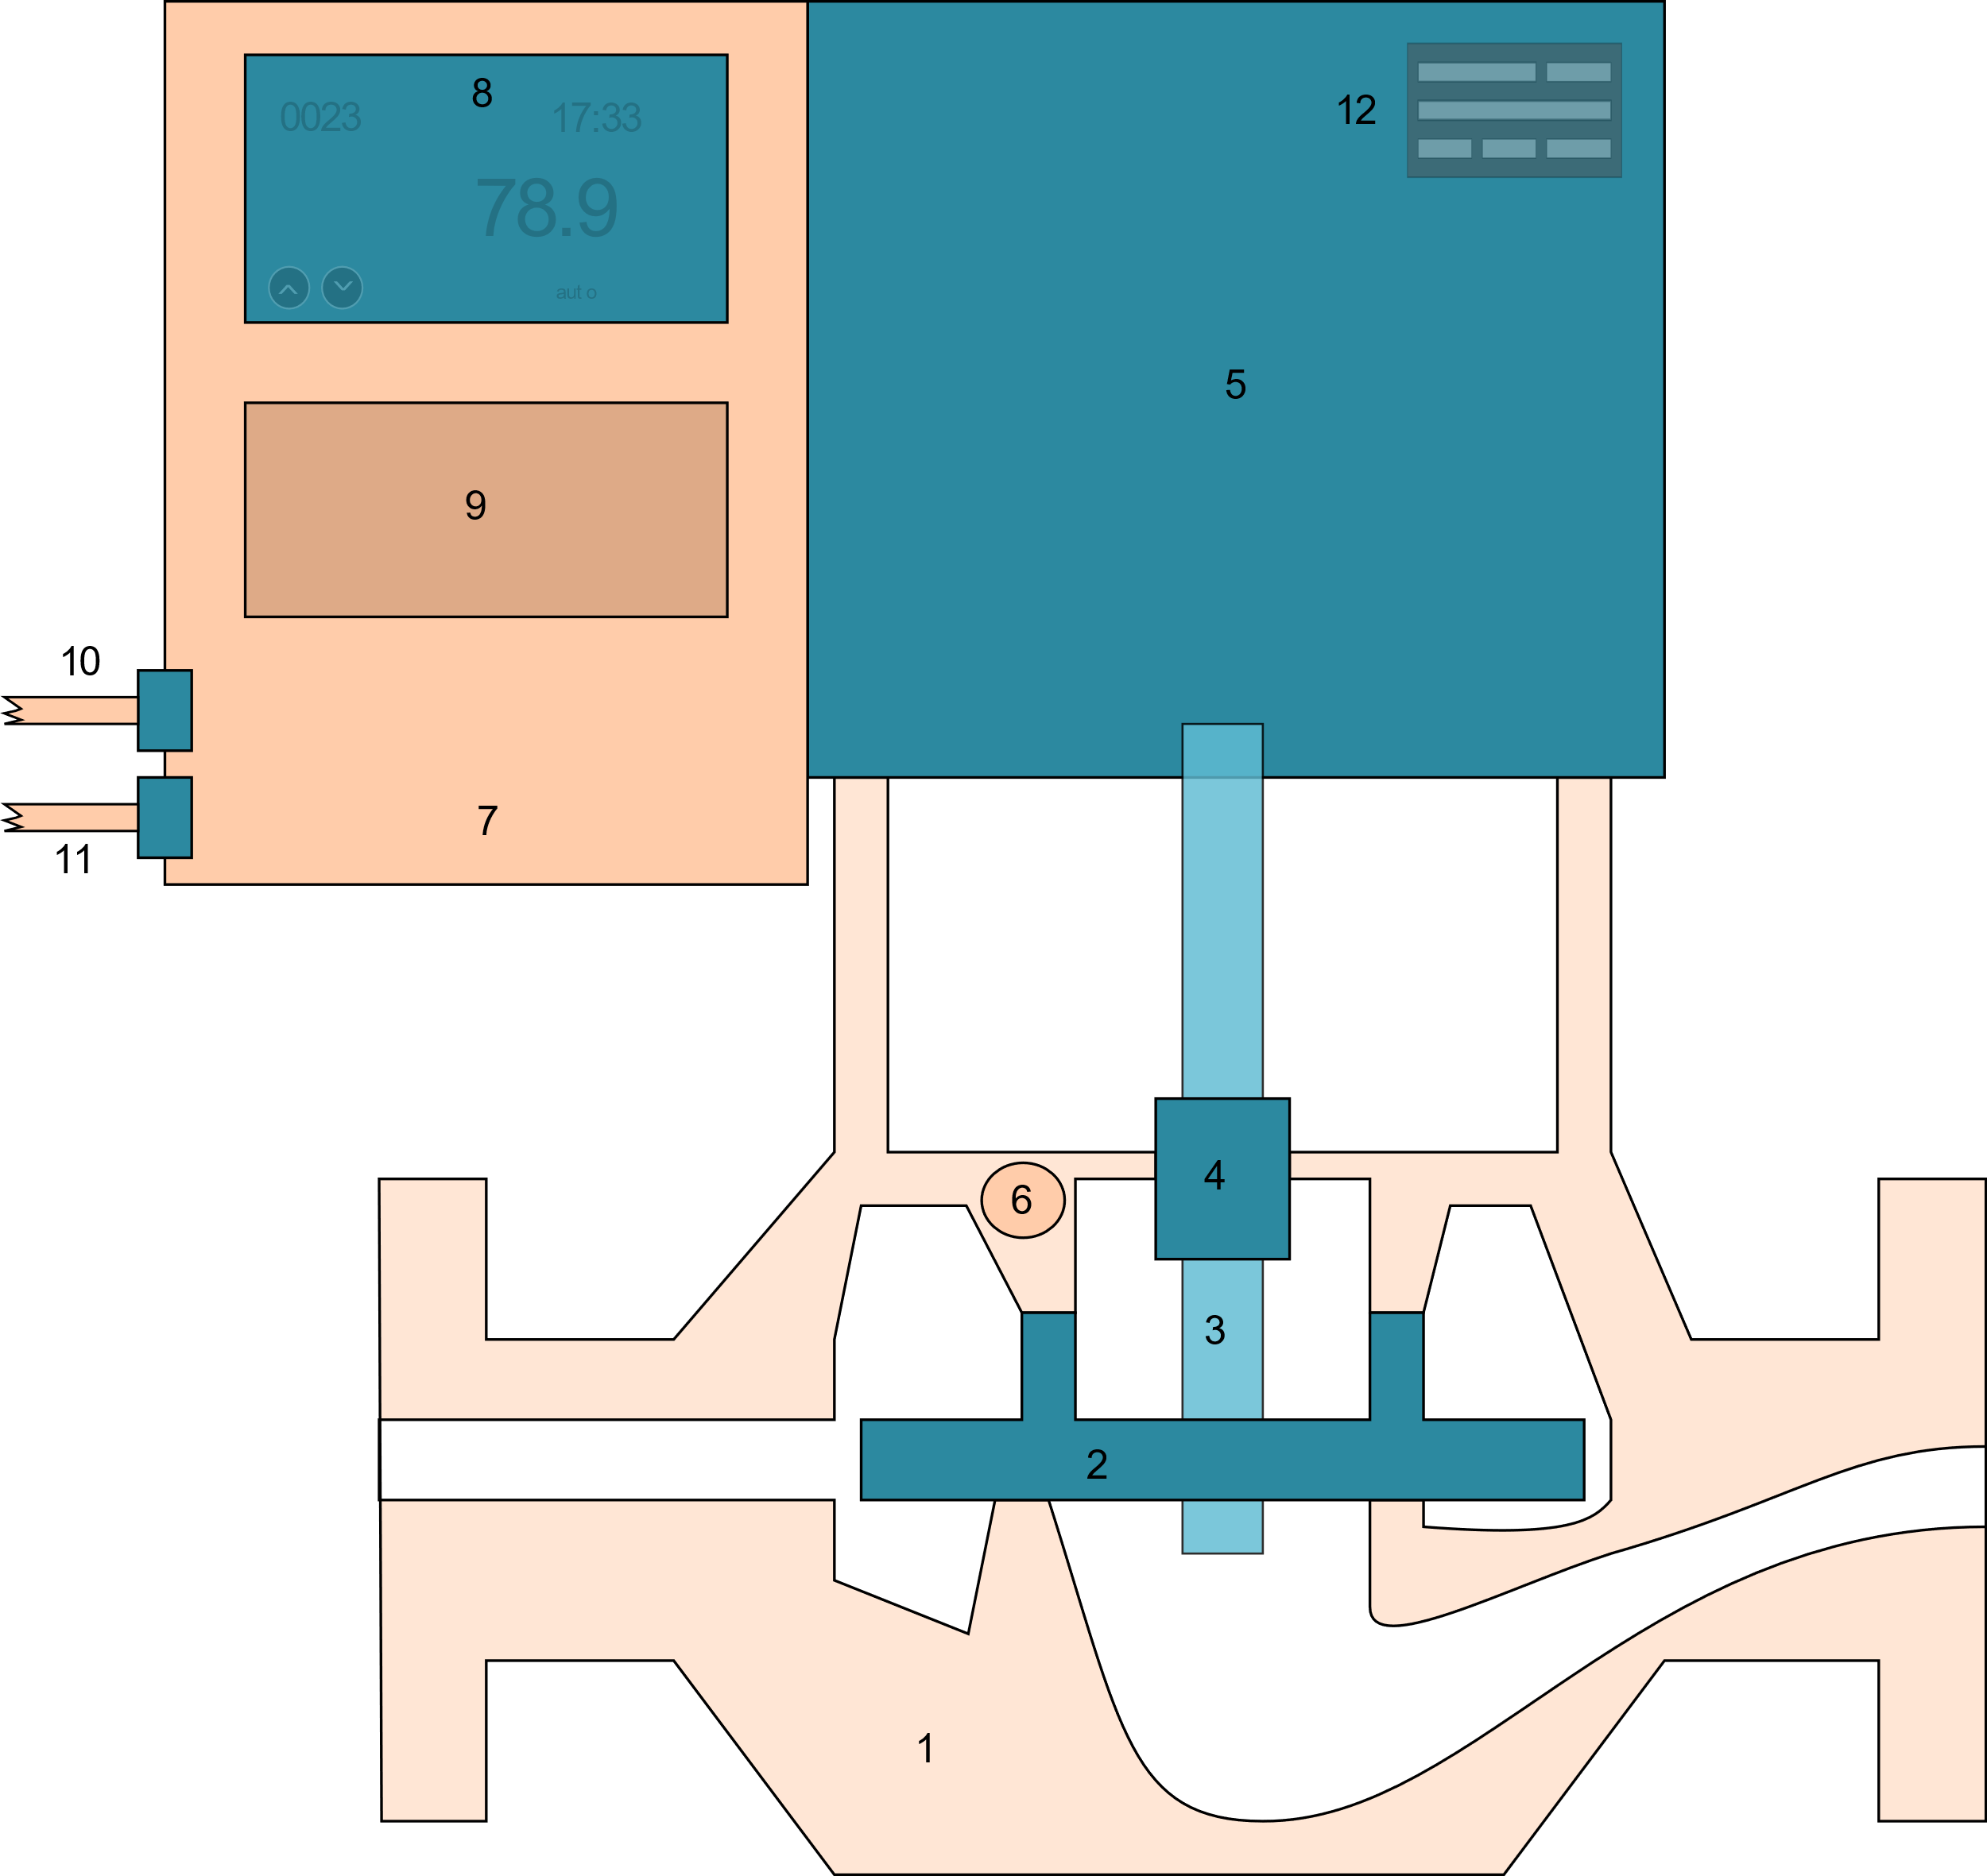

Automated verification of measurement precision for Internet-of-Things equipment
W3C Web of Things Community Group 2023
Mikkel Haggren Brynildsen, Grundfos, Caitlin Woods, UWA/Grundfos, Johan Klüwer, DNV, Maja Milicic Brandt, Siemens, Melinda Hodkiewicz, UWA
1

Slide 2
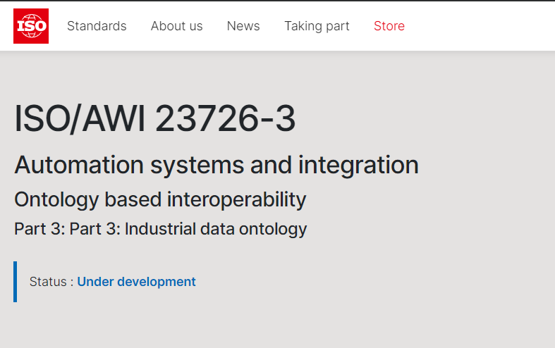
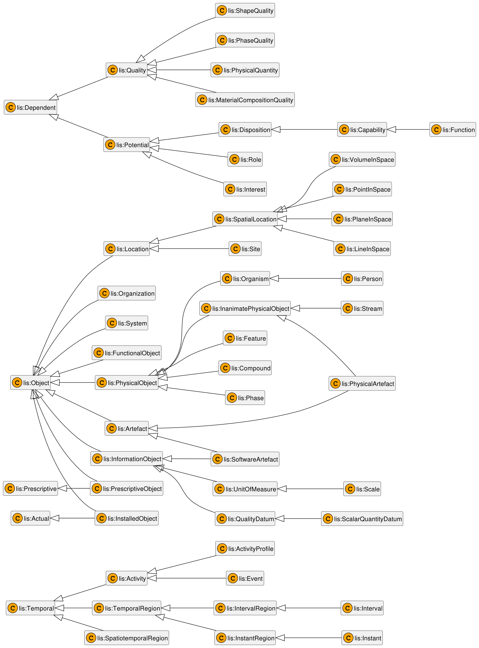
What is Industrial Data Ontology (IDO) exactly?
ISO/AWI 23726-3 (IDO) is part of ISO/AWI 23726 (OBI) (Ontology-Based Interoperability) managed by ISO / TC 184 / SC 4 Industrial Data
“An ontology for representing industrial data and information, building vocabularies and manage asset models that employ reference data libraries and exploit OWL reasoning”
Derived from / inspired by
ISO 15926-2:2003
ISO/IEC 21838-2:2021 – Basic Formal Ontology (BFO)
Formulated in W3C’s OWL 2 language
Enables precise modelling
54 classes, 4 datatype properties, 88 object properties
Developed and applied in Norwegian Energy (O&G) industry
Formerly known as ‘ISO 15926-14 Data model adapted for OWL2 Direct Semantics’
IDO’s concepts and relationships
2
Brandt, Brynildsen, Hodkiewicz , Klüwer, Woods @ ISWC2023

Slide 3
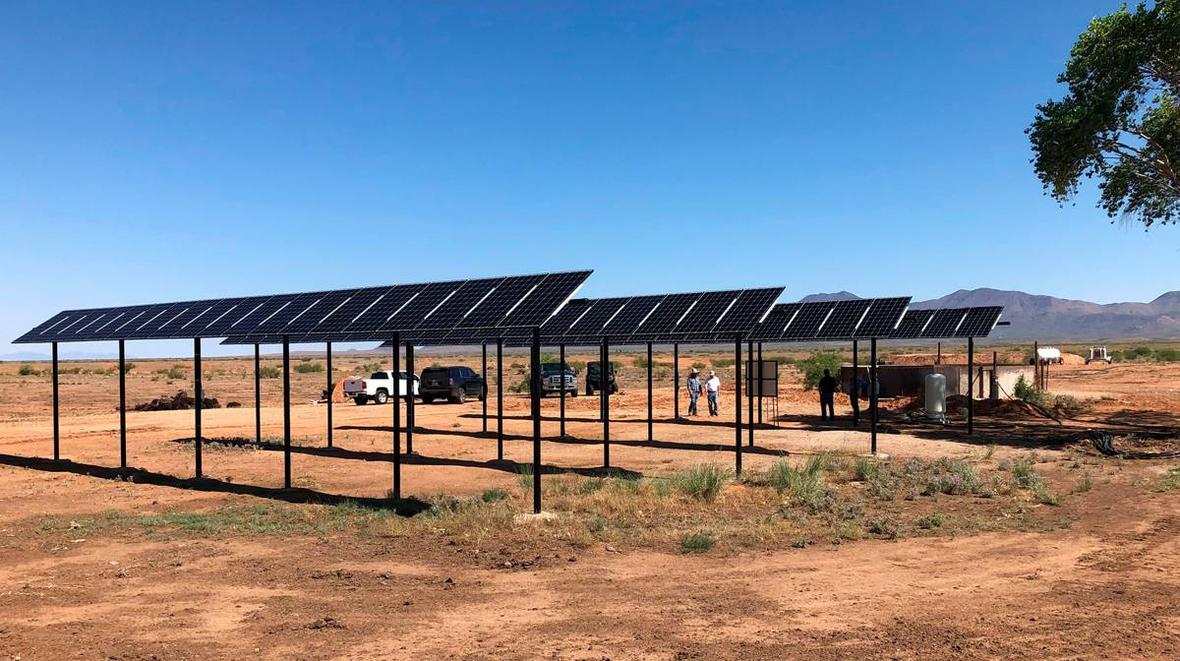




GRUNDFOS
Domestic Buildings
Commercial Buildings
Industry
Water Utility
3
Brandt, Brynildsen, Hodkiewicz , Klüwer, Woods @ ISWC2023

Slide 4




GRUNDFOS
Domestic Buildings
Commercial Buildings
Industry
Water Utility
Water Utility, Embedded SW .
Water Utility, Cloud Solutions .
4
Brandt, Brynildsen, Hodkiewicz , Klüwer, Woods @ ISWC2023

Slide 5
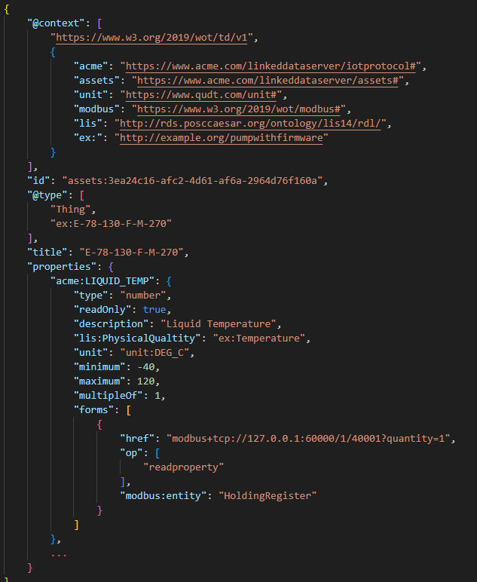
GRUNDFOS
Domestic Buildings
Commercial Buildings
Industry
Water Utility
WoT “Thing Description FIle
Water Utility, Embedded SW .
Water Utility, Cloud Solutions .
5
Brandt, Brynildsen, Hodkiewicz , Klüwer, Woods @ ISWC2023

Slide 6
IDO based model
Goal:
Engineers document their engineering using standardized digital artifacts (SysML, UML, WoT, IEC/ISO 81346,…)
We can store and retrieve master data about what software is combined with what hardware for enterprise-size portfolio (~600.000 types of pumps).
Reuse RDF community released standardized IDO modelling patterns and reasoning modules for equipment, qualities and quality data (POSC Caesar Association (PCA)).
We want to minimize the amount of bespoke semantic analysis scripts being written.
6
Brandt, Brynildsen, Hodkiewicz , Klüwer, Woods @ ISWC2023

Slide 7
IDO use case
“Pump with firmware”
Software estimate
Liquid temperature
2) Activity: down sampling to pump memory
3a) Activity: estimate Liquid temperature
Temperature sensor (from supplier) measures pump housing temperature
IoT data stream:
Pumped liquid temperature
3b) Activity: serve liquid temperature estimate
1) Activity: housing temperature observation (sensor memory)
Pumped Liquid temperature
is not directly measured, but estimated
7
Brandt, Brynildsen, Hodkiewicz , Klüwer, Woods @ ISWC2023

Slide 8
Data resolution
Sensor Calibration: min = -40 °C
max = 120 °C
42
4 bit register (memory)
Analog to digital
1
0
0
0
Q: How many “buckets”? Answer: 2^4 = 16
Binary value | 0000 | 0001 | … | 1000 | … | 1110 | 1111
Temp range | 0°C - 10°C | 10°C-20°C | … | 40°C - 50°C | … | 100°C - 110°C | 110°C - 120°C
Percentage range | 0 - 0.0625 | 0.0625 -0.125 | … | 0.5 - 0.5625 | … | 0.875 - 0.9375 | 0.9375 - 1
42 goes here
object
8
Brandt, Brynildsen, Hodkiewicz , Klüwer, Woods @ ISWC2023

Slide 9
Data resolution
Sensor Calibration: min = -40 °C
max = 120 °C
1
0.0625
“fullSpanPercentageStepSize” = 0.0625
0.0625
42
…
4 bit register (memory)
0.0625
0.0625
Analog to digital
1
0
0
0
…
0.0625
0.0625
0.0625
0
Q: How many “buckets”? Answer: 2^4 = 16
Binary value | 0000 | 0001 | … | 1000 | … | 1110 | 1111
Temp range | 0°C - 10°C | 10°C-20°C | … | 40°C - 50°C | … | 100°C - 110°C | 110°C - 120°C
Percentage range | 0 - 0.0625 | 0.0625 -0.125 | … | 0.5 - 0.5625 | … | 0.875 - 0.9375 | 0.9375 - 1
42 goes here
object
8
Brandt, Brynildsen, Hodkiewicz , Klüwer, Woods @ ISWC2023

Slide 10
IDO based model
WoT Standardized Information Handover
{
"@context": [
"https://www.w3.org/2019/wot/td/v1",
{
"acme": "https://www.acme.com/linkeddataserver/iotprotocol#",
"assets": "https://www.acme.com/linkeddataserver/assets#",
"unit": "https://www.qudt.com/unit#",
"modbus": "https://www.w3.org/2019/wot/modbus#",
"lis": "http://rds.posccaesar.org/ontology/lis14/rdl/",
"ex:": "http://example.org/pumpwithfirmware"
}
],
"id": "assets:3ea24c16-afc2-4d61-af6a-2964d76f160a",
"@type": [
"Thing",
"ex:E-78-130-F-M-270"
],
"title": "E-78-130-F-M-270",
"properties": {
"acme:LIQUID_TEMP": {
"type": "number",
"readOnly": true,
"description": "Liquid Temperature",
"lis:PhysicalQualtity": "ex:Temperature",
"unit": "unit:DEG_C",
"minimum": -40,
"maximum": 120,
"multipleOf": 1,
"forms": [
{
"href": "modbus+tcp://127.0.0.1:60000/1/40001?quantity=1",
"op": [
"readproperty"
],
"modbus:entity": "HoldingRegister"
}
]
},
...
}
}
WoT Thing Description files
Standardized IoT profiles about pumps.
https://www.w3.org/WoT/
“The LIQUID_TEMP range is
[-40, -39, -38, …, 119, 120]
10
9
Brandt, Brynildsen, Hodkiewicz , Klüwer, Woods @ ISWC2023

Slide 11
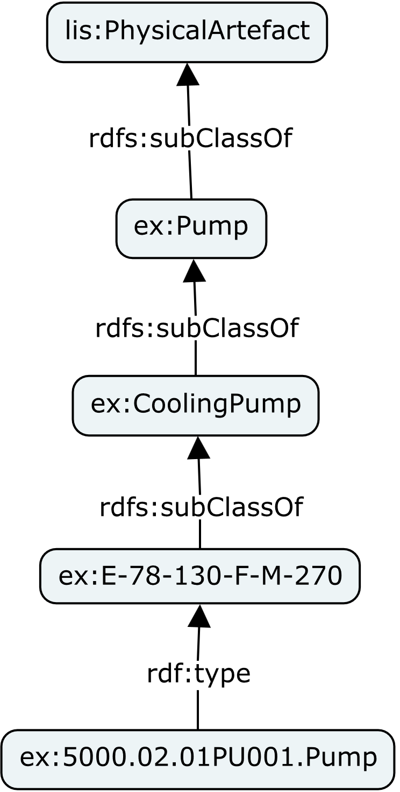
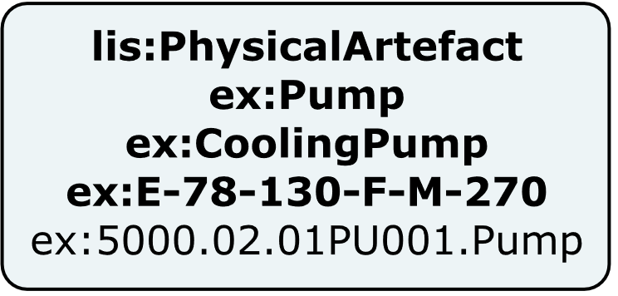
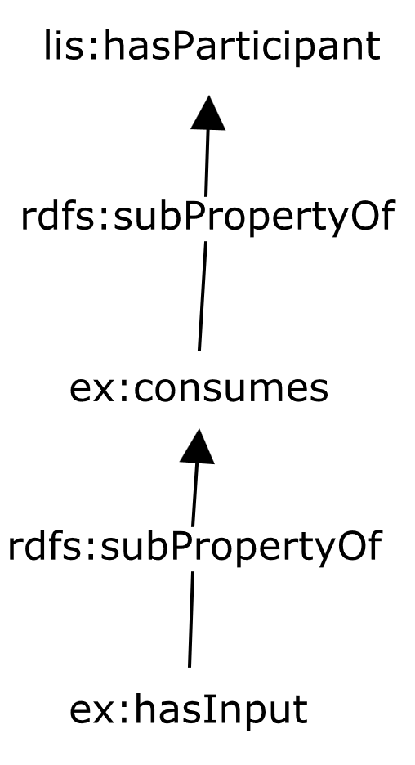
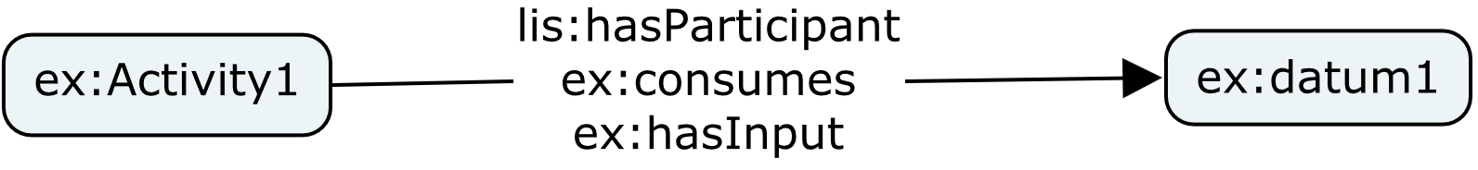
Visual language
Is visual shorthand for
Is visual shorthand for
10
Brandt, Brynildsen, Hodkiewicz , Klüwer, Woods @ ISWC2023

Slide 12
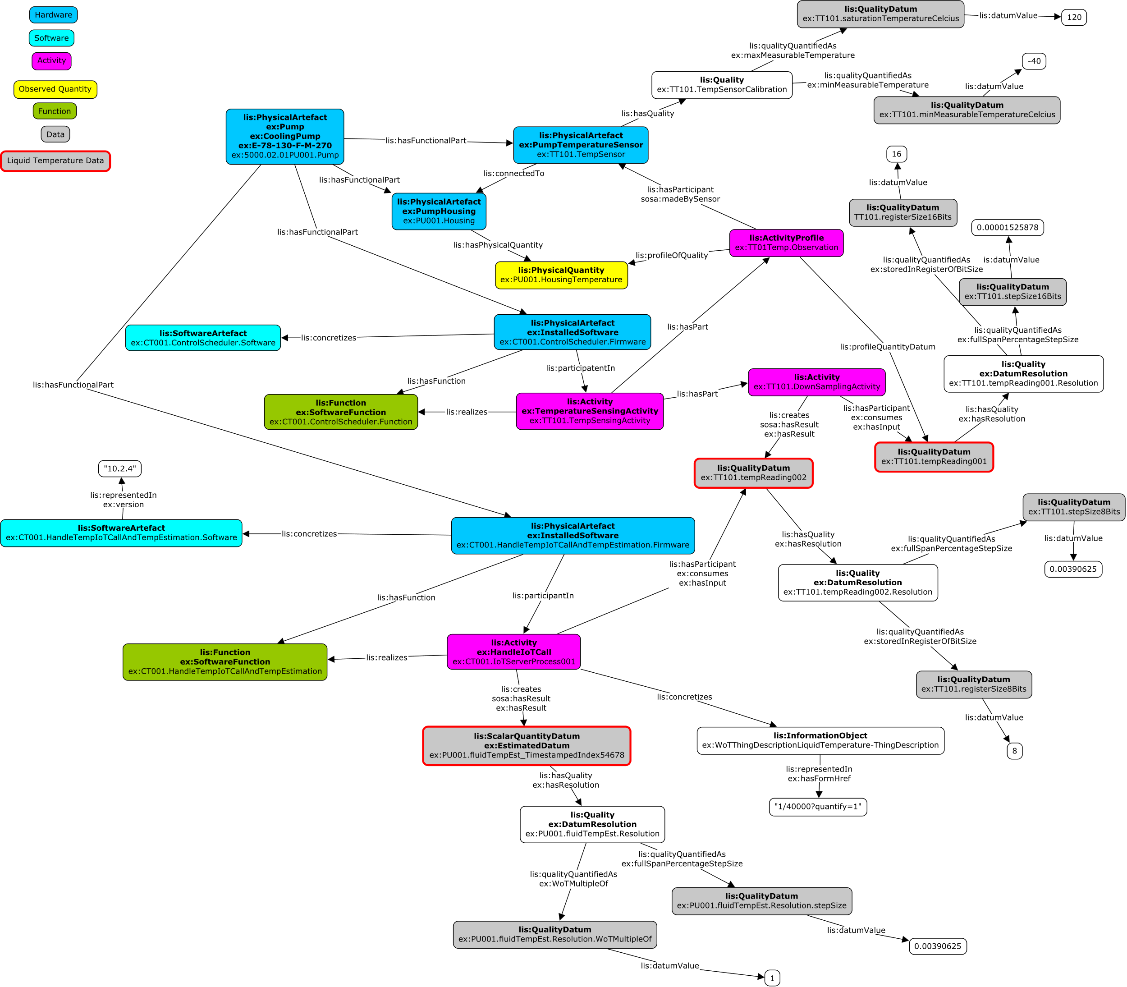
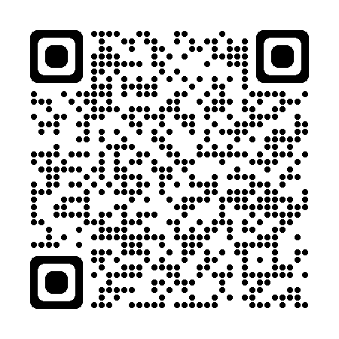
IDO use case
“Pump with firmware”
Based partly on patterns here:
https://rds.posccaesar.org/doc/patterns/
11
Brandt, Brynildsen, Hodkiewicz , Klüwer, Woods @ ISWC2023

Slide 13
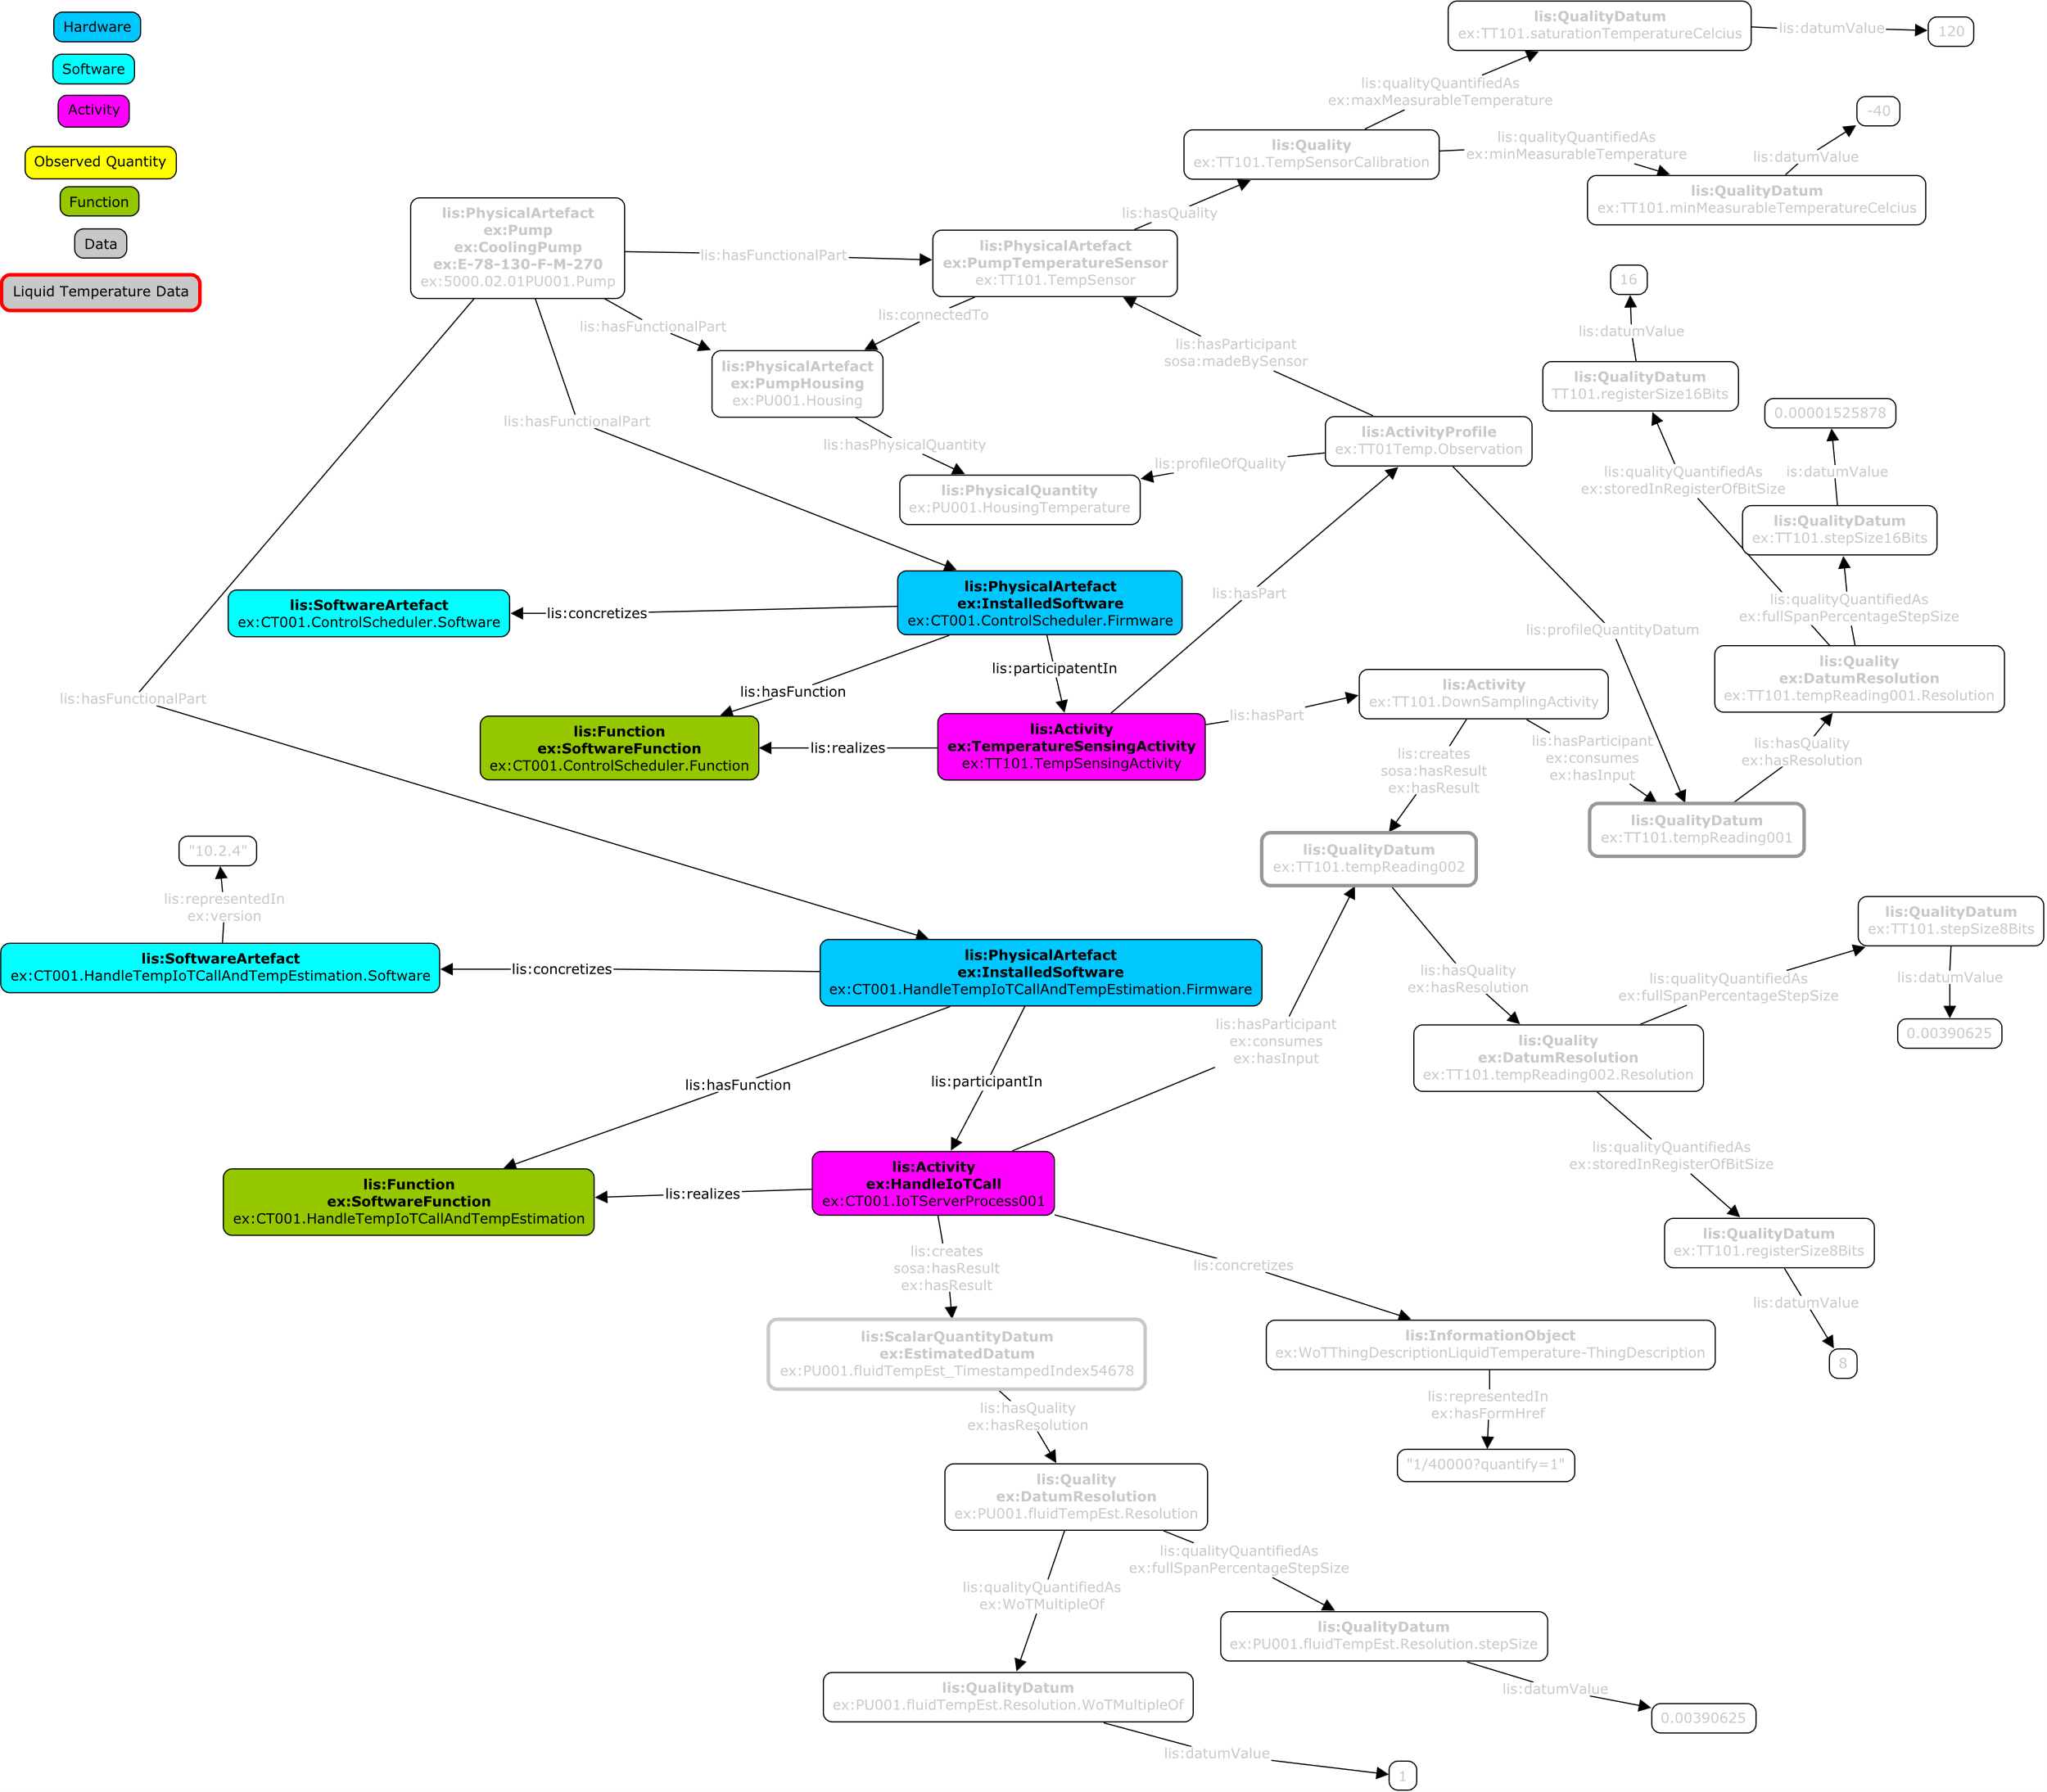
IDO use case
“Pump with firmware”
Installed Software pattern
12
Brandt, Brynildsen, Hodkiewicz , Klüwer, Woods @ ISWC2023

Slide 14
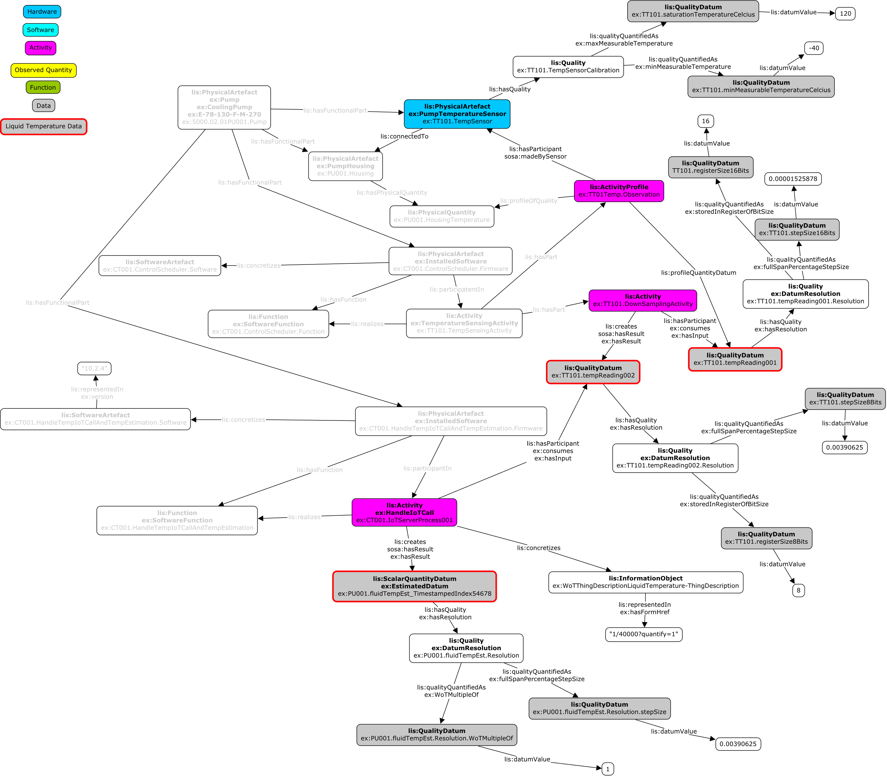
IDO use case
“Pump with firmware”
Validation
check that in data processing activities:
percentage resolution input <= percentage resolution result
percentage resolution input
percentage resolution result
13
Brandt, Brynildsen, Hodkiewicz , Klüwer, Woods @ ISWC2023

Slide 15
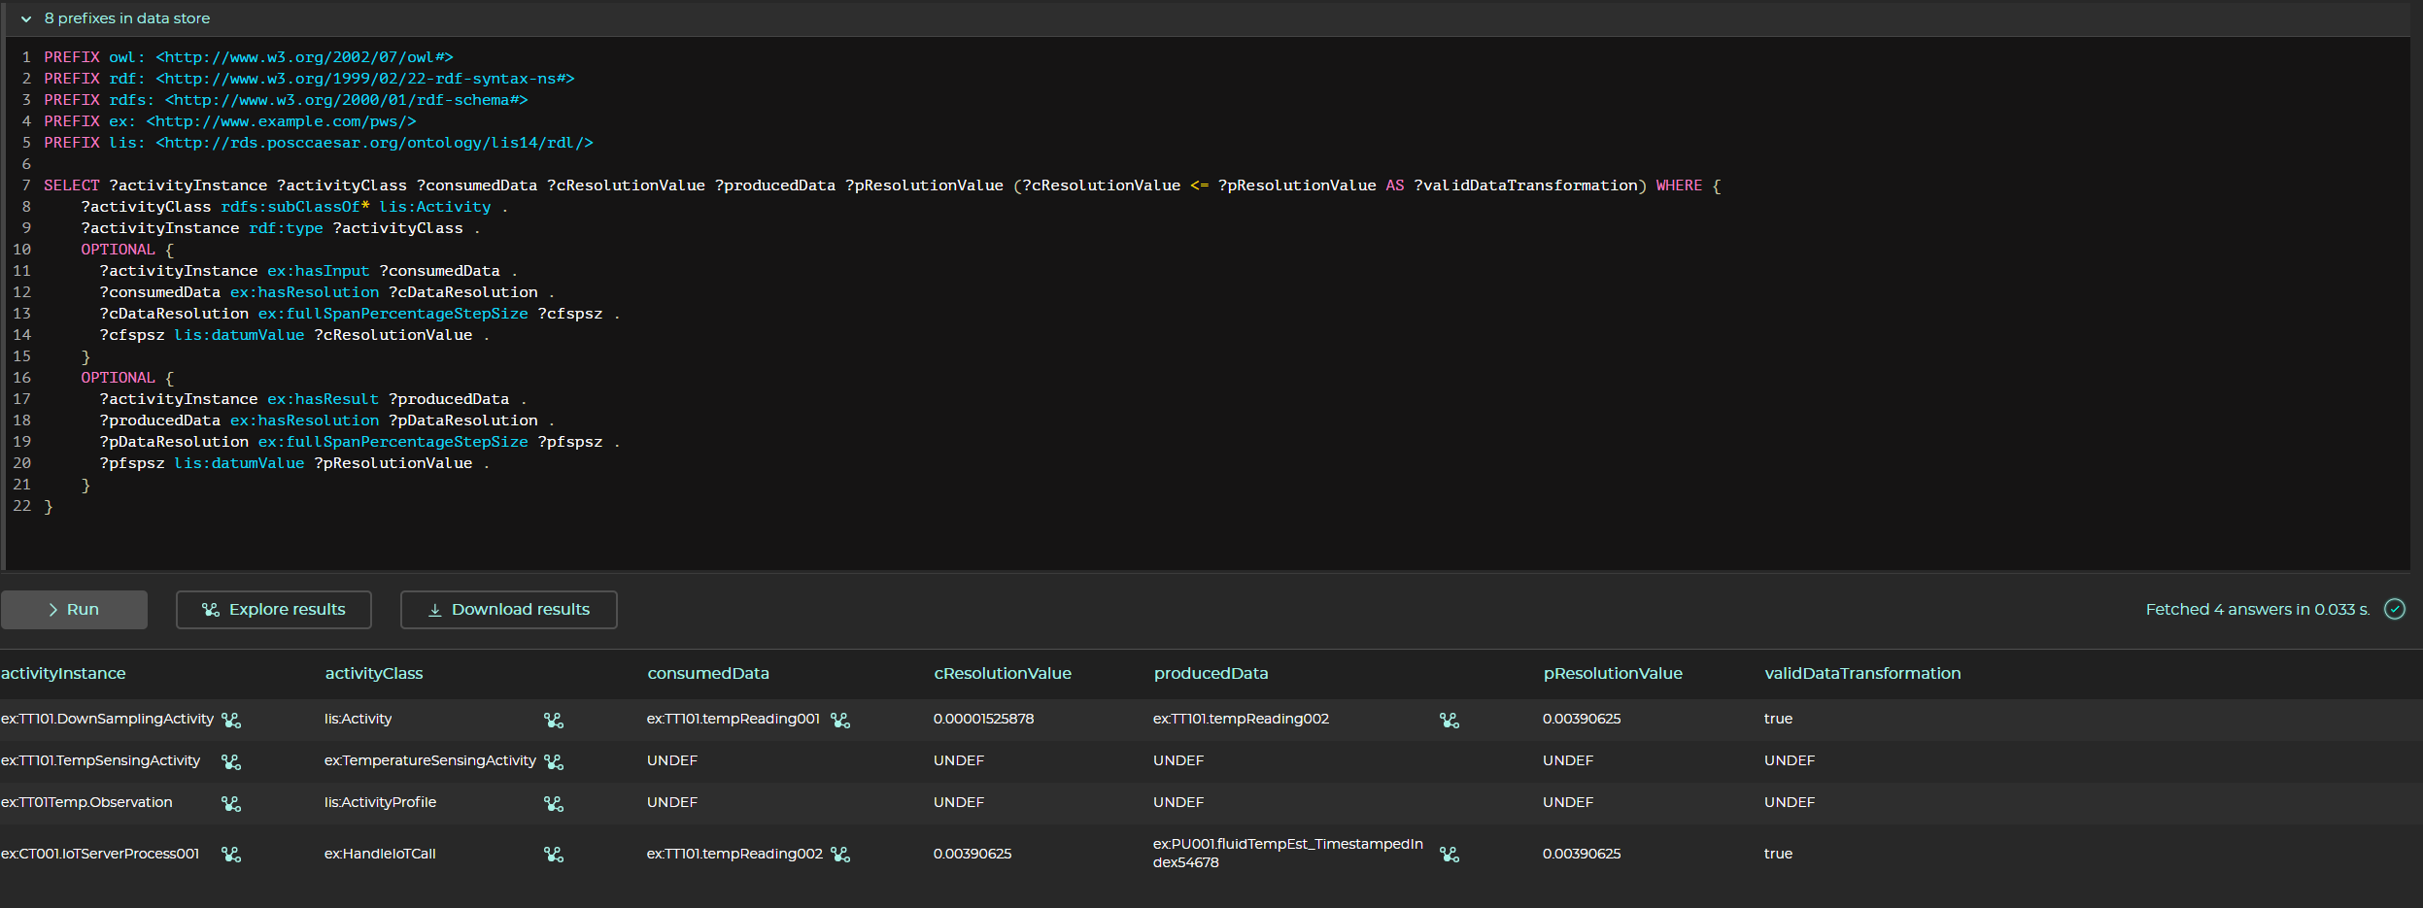
Demo query
14
Brandt, Brynildsen, Hodkiewicz , Klüwer, Woods @ ISWC2023

Slide 16

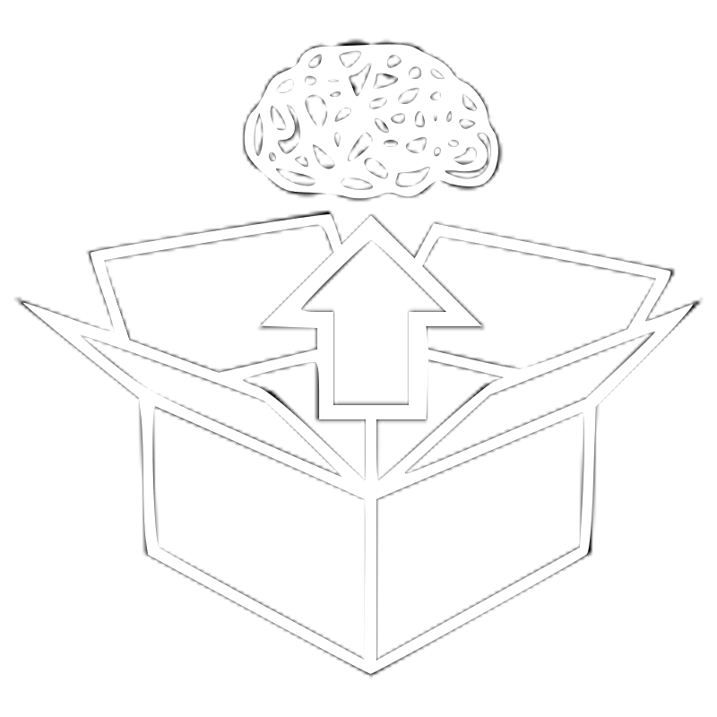

IDO based model, benefits
+
=
Digital offerings and the connectivity teams get standardized quality operating instructions (WoT TD Files) for IoT products on demand to produce digital offerings.
In product development: IoT Profiles of new and changed IoT products can be validated, on the combined HW+SW perspective.
The Enterprise can roll out hot-fixes and new IoT features to all digital offerings through a streamlined standards-based system.
The Enterprise can expand the information handover system to handle external manufacturers IoT operating instructions. The modelling is based on industry standards. IoT alliances can be build.
15
Brandt, Brynildsen, Hodkiewicz , Klüwer, Woods @ ISWC2023

Slide 17
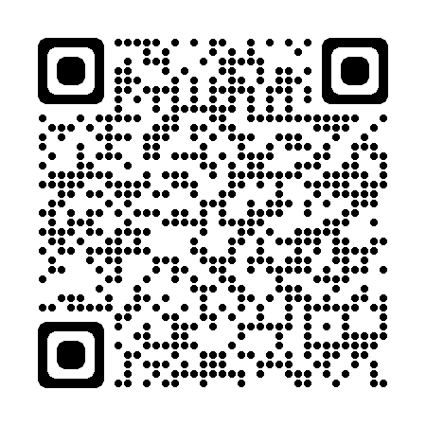
References
ISO/AWI 23726-3
https://www.w3.org/WoT/
https://rds.posccaesar.org/
Contact:
mbrynildsen@grundfos.com
Thank you!
“IDO” iso.org page
16
Brandt, Brynildsen, Hodkiewicz , Klüwer, Woods @ ISWC2023

